Slide 1

GO HIGHER
How to play: control your character, calculate the angle shooting as well as the firing power of the slingshot to help your character jump on higher pieces of land to reach deep in the floating castle, on the way there are many obstacles as well as diamonds, you can own new characters by earning lots of diamonds, each character will have a different advantage.

Slide 2
100% CASUAL GAME
EASY TO PLAY – HARD TO MASTER

Slide 3
The mechanics are simple: drag the slingshot to calculate the power and the angle shooting to help your character go higher. You should carefully before you drop the slingshot, because once you are in the air there is no way to turn back!

Slide 4
DEMO IMAGES

Slide 5
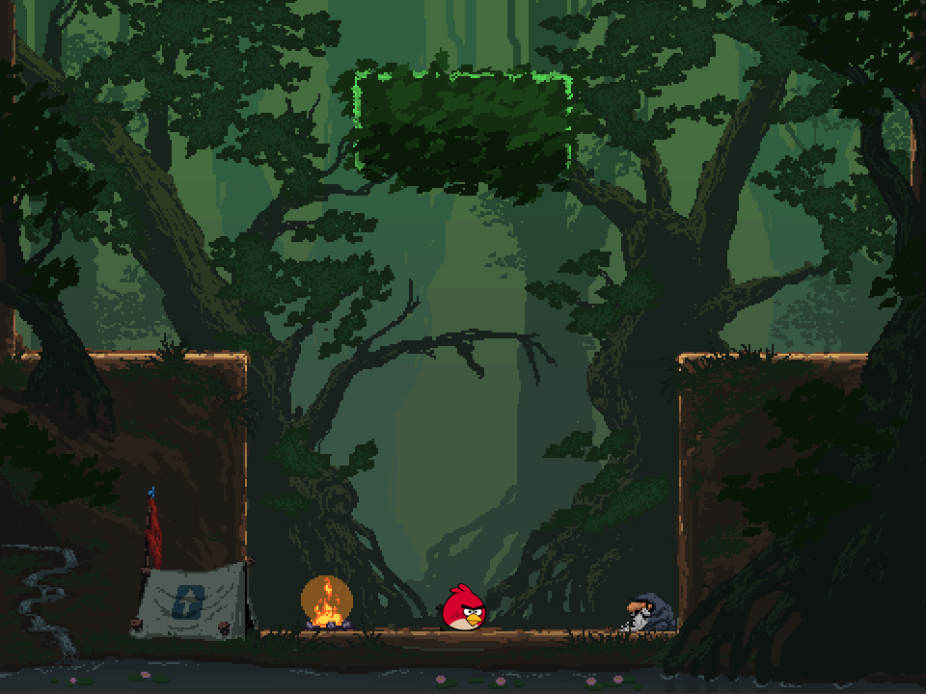

Slide 6
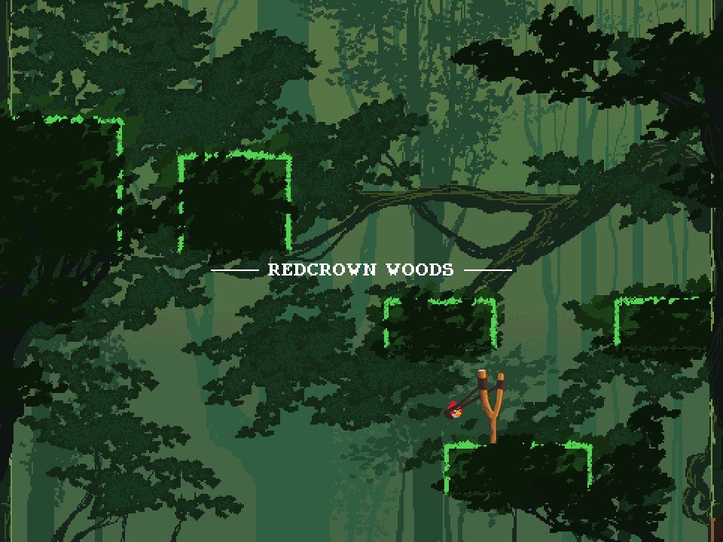

Slide 7
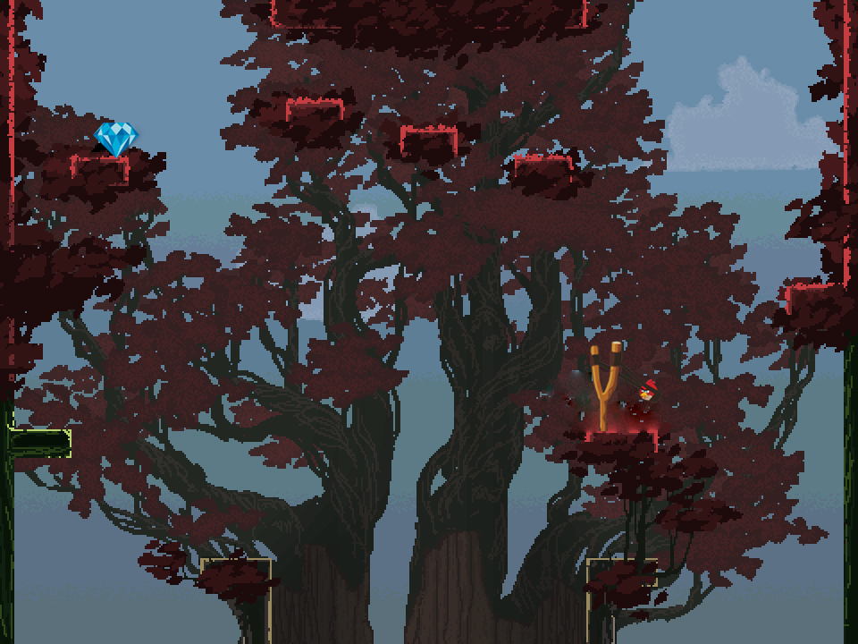

Slide 8
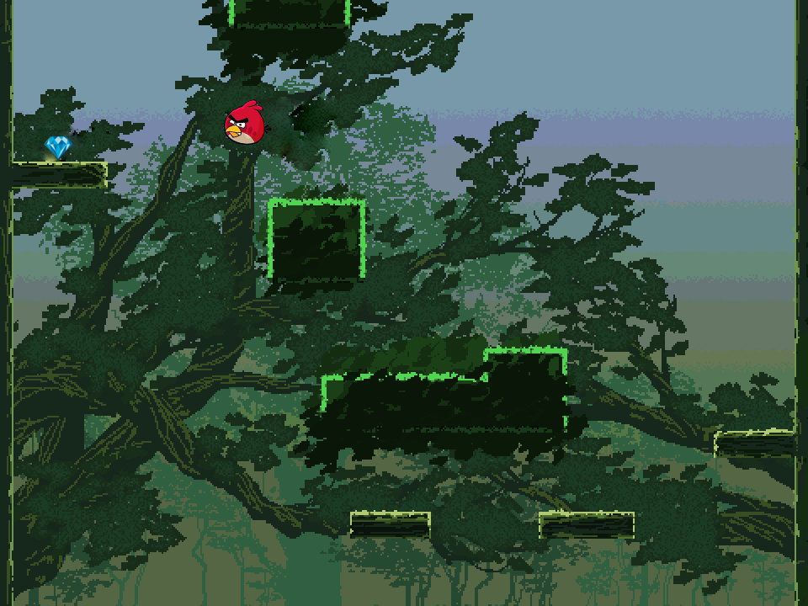

Slide 9
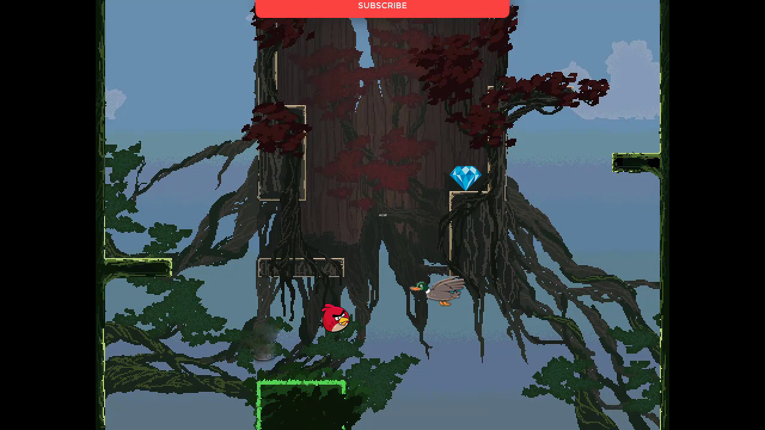

Slide 10
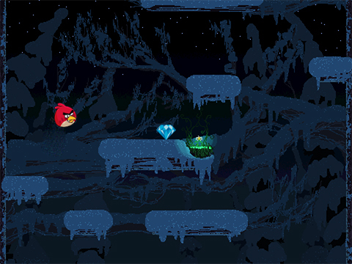

Slide 11
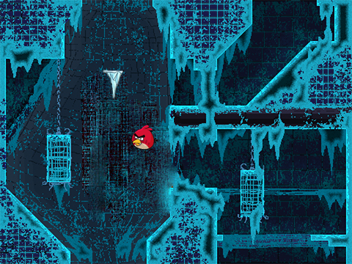

Slide 12
THANK YOU FOR LISTENING

